Slide 1

Restaurant Management System
Team Members:
Deepanshu Tyagi
Vikas Jangra

Slide 2
TEAM tasks:
DATABASE DESIGN
IMPLEMENTATION
TESTING

Slide 3
Table of Content:
What is Restaurant Automation?
Existing System
Why E-Restaurant?
POS
Our Innovation
How does it works?
Development Process:
1. Functionalities
2. Used Technology
3. Design
4. User Interface

Slide 4

What is Restaurant Automation?
It is a system that simplifies ordering within a traditional restaurant.
This system helps restaurant personnel coordinate their activities and improve their services, and for the management to track business growth and create future plans.
E-billing service instead of paper bill.
Typical problems restaurant personal are facing includes:
1. Coordination of their work activities.
2. Lowering operating costs, and increasing benefits.

Slide 5

EXISTING SYSTEM
Lots of system are semi-manual.
Every business process is on paper.
Business information is generated by employees.

Slide 6

Why Automation?
It saves time.
It saves money.
Eliminates arithmetic errors.
It makes interaction client-staff easier.
Tracking of every transaction is very easy.
It decreases the amount of work you have to do?
More secure than normal method.
Although this concept is of automation, still manual labour
is not affected.
POS concept.

Slide 7
POS
A Point of Sale system is either stand-alone machine or a network of input and output devices.
Restaurant employees can accomplish their daily activities.
Food and beverage orders.
Transmission of tasks to kitchen.
Calculating and printing bills.
History of previous orders.

Slide 8
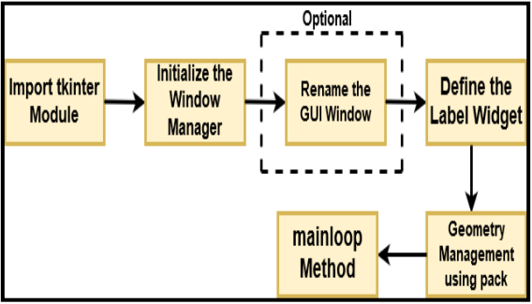
Rendering Basic GUI:

Slide 9
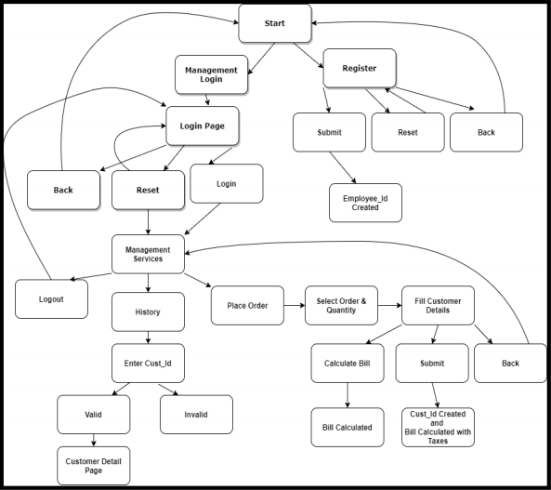
Workflow of Project:

Slide 10
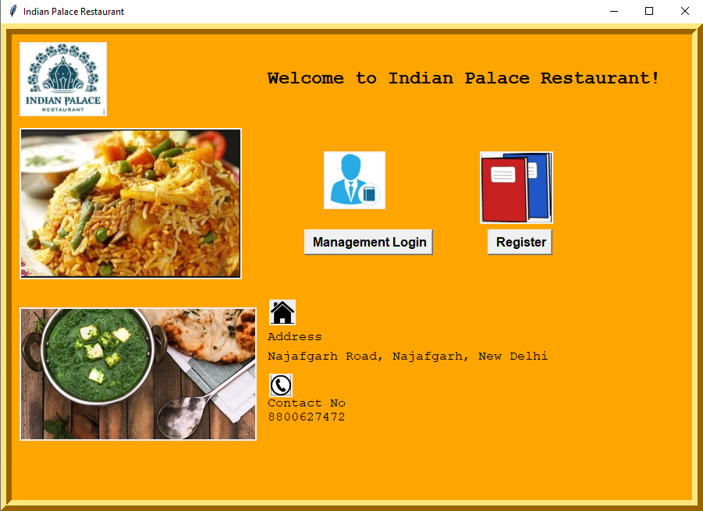
Master Frame of the application:

Slide 11
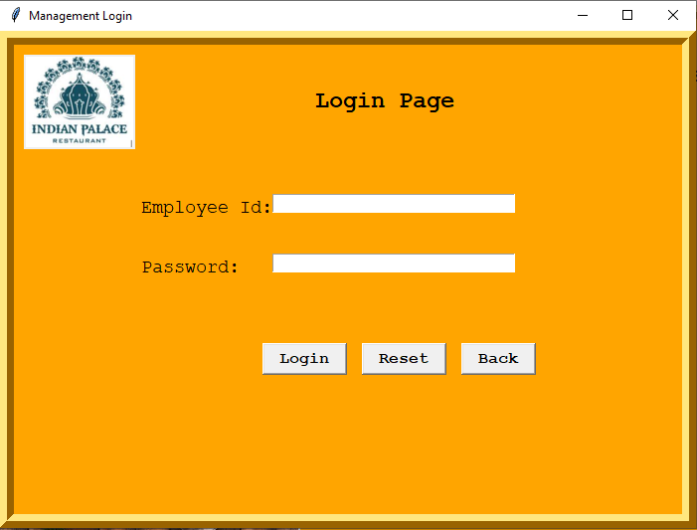
Login Frame/ Window:

Slide 12
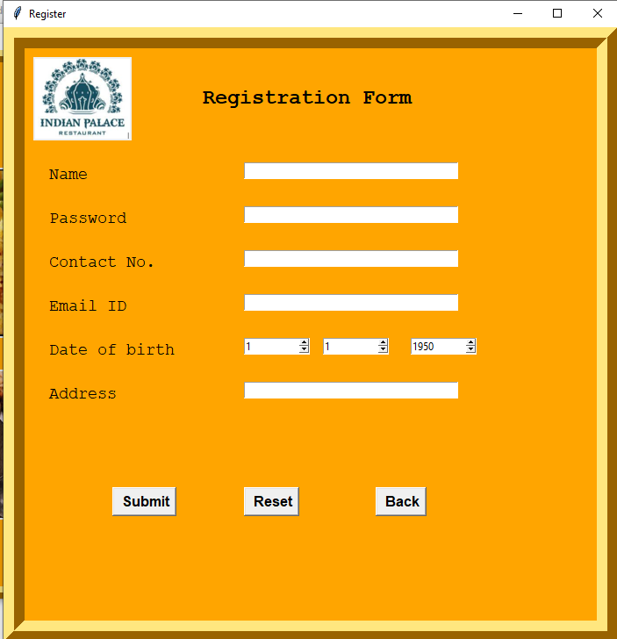
Registration of a New Member:
IF Values entered correctly:
Employee ID will be generated.
But HOW???
1. conn=sqlite3.connect("database1.db")
2. cursor = conn.execute("select * from emp_det”)
3. value = cursor.fetchall()
4. leng = len(value)
5. emp_id = value[leng - 1][0] + 1
IF incorrect input value entered (exception can be):
1. User already exists.
2. Invalid name (if numeric data entered in name field ).
3. Invalid contact number(If 10 digit data is not entered).
4. Invalid email id.
5. Fill all the fields.(If any fileld remains empty)

Slide 13
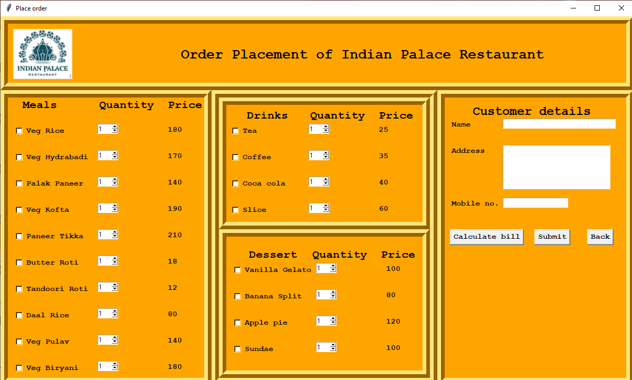
Placing an order & calculating bill:
After selecting the items from the list. The selected checkbutton field (variable field) will be marked as 1.
Total bill can be calculated by using calculate bill button.
After Submitting the bill: Customer id and order number will be generated.
Using the last customer id and order number.

Slide 14
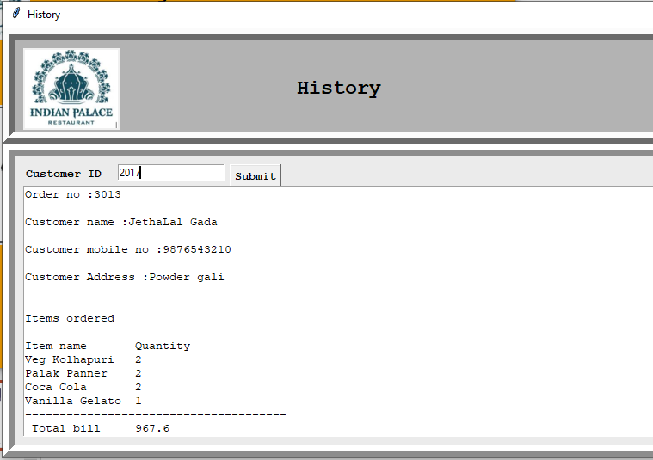
Viewing History:
By using CUSTOMER_ID history of the customer can be easily viewed.
Order history will be retrieved from the “database1” from table HISTORY.
Using query:"select order_no from history where cust_id="

Slide 15
Database:
SQlite3 can be integrated with Python using sqlite3 module.
To use sqlite3 module, you must first create a connection object that represents the database and then optionally you can create a cursor object, which will help you in executing all the SQL statements.
Connect to database:
Import sqlite3
Conn=sqlite3.connect(‘database1.db’)
print”Opened database successfully”;

Slide 16
Tables of Database:
Cust_det(cust_id(primary key), cust_name, cust_mno, cust_address)
Item(Item_id(primary key), item_name ,price)
History(order_no(primary key), cust_id, item_nos, quantity, bill)
Emp_details(emp_id(primary key), emp_name, emp_no , emp_add, emp_add, emp_dob, emp_email, emp_password)

Slide 17
Conclusion:
The project created can be used by any of the small-scale hotels and restaurants or a food truck, which are moving to digital life and need a simple to use the app in the beginning. The app is safe and secure to use and can be used by any organization with just a few clicks and the use of a traditional method like pen-paper can be replaced.

Slide 18


